Slide 1
Salesforce.com Org Consolidation
Deloitte Consulting LLP
March 6, 2012

Slide 2
Salesforce.com Org Consolidation
What challenges have been encountered so far ?
Has a roadmap been established for this consolidation ?

Slide 3
Org Consolidation Challenges
Based on our experience, major challenges with org consolidation are around business process re-design, introduction of a centralized governance model, release strategy, and managing the loss of autonomy by specific business units
Business Process Consolidation | Consolidate business processes across business units prior to application and system design Understanding of variations in business processes and how they should be handled
Collaboration | Increase in collaboration on process, data, and release priorities due to one single instance Clear owners and decision makers representing each business unit
Governance | Centralized governance model across different BUs requires rigor around process and solution enablement Enforce change control in target system to ensure patches and fixes are accounted for during development
Data Security and Visibility | Define organizational role hierarchy early to facilitate agreement on consolidated roles. This requires buy-in, feeds into reporting, and takes time
Technology | Define target users early in order to progress data migration and configuration activities Understand existing design and configuration dependencies across source systems Rationalize of key customizations and whether they are needed in a consolidated instance
People | People from different Bus and regions need to be authorized / empowered to make these decisions to represent the business units Be aware of tribal knowledge. Often times there is no one who knows why the system setup was done the way it operates currently
Copyright © 2011 Deloitte Development LLC. All rights reserved.

Slide 4
Success in Org Consolidation depends on several key factors
Keys to Success
Think Business Led, Technology Enabled
Simplify and Standardize Processes
Senior business executive needs to have skin in the game. Have clear owners and decisions makers for each of the business units that are merging
Maintain simple and clearly defined business and IT accountability for program strategy, successful delivery and adoption
Staggered, high-touch, deployment, training and support model
Implement effective communication, with the “WIIFM” message (“What’s In It For Me”) throughout the effort
Drive alignment around simplified, consistent processes to the greatest extent possible while accommodating regions and/or business units unique requirements
Tribal knowledge around process and customization doesn't work
Keep it flexible – Avoid over automation in initial releases
Keep it practical – make sure the organization and technology support it
Learn and adjust – continually review process effectiveness and revise to maximize value
Get The Data Architecture Right
Don’t Replicate The Old in The New
Utilize leading practices to drive the new data architecture
Focus on making sure the data set in the consolidated salesforce.com org is clean, actionable and what’s needed to support the business processes (not what you have)
Relentless focus on data quality and governance
Carefully define and manage data volumes in key tables
Avoid reverse engineering and replication of the current state solution. Take advantage of native salesforce.com functionality to optimize performance and protect investment
Move to a more “Agile” / iterative delivery model
Refocus IT skills and investment in higher value roles and ways of supporting the business
Have a mobile strategy

Slide 5
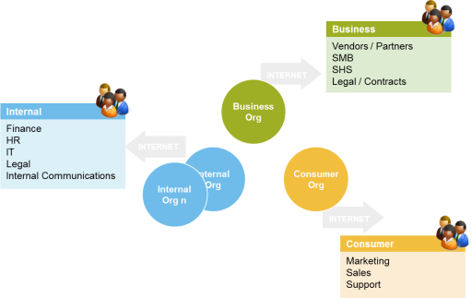
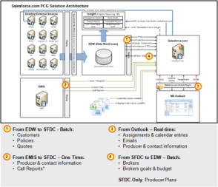
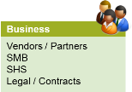

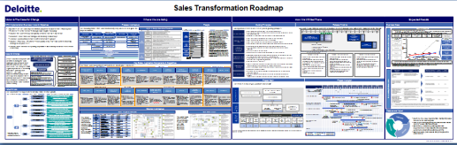
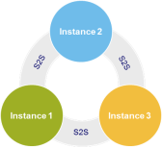
Salesforce.com capabilities – instance consolidation
1
Current State
2
Target Solutions Architecture and Process Alignment
4
Potential Future State
3
Develop a Functional & Technology Roadmap
Single
or
How Deloitte Can Help
Drive the business model and process alignment efforts
Build a capability framework to establish the overall functional capabilities across all business lines
Help the core team align common processes towards a global model while managing the variability of local requirements
Shape the target solutions architecture
Define the different dimensions of the target state architecture (application, integration and data)
Map the path forward
Develop the delivery roadmap for target state processes and solution in a manner that the sales teams will adopt
Establish Center of Excellence for successful implementation
Implement clear ownership model and governance process for key releases and develop code rationalization and data migration strategy

Slide 6
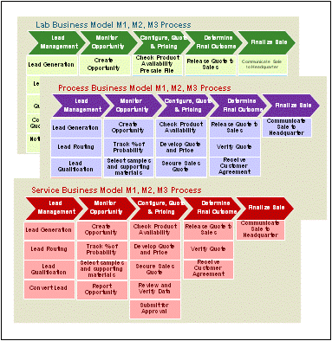
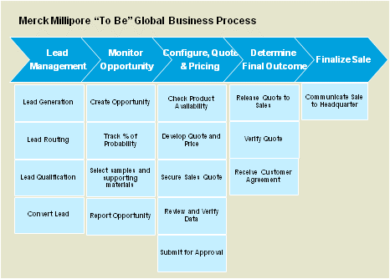

Approach – Capability & Business Process Positioning
At the heart of our effort is the need to streamline the approach to capabilities and business process and supporting activities
 | Approach |  |  | Outputs
 | Interview Key Stakeholders across all business groups and functions | Business Capability & Process Workshops | Enterprise Process Alignment Working Sessions | Aligned View Of Target Business Model(s) & Supporting Core Sales Processes
Objectives | Proactive working sessions with key stakeholders individually and grouped to validate current processes and capabilities, identify pain points and align with overall corporate objectives | Understand primary Business Models with stakeholders Develop hypothesis relative to process profiles to be utilized in process workshops Create process profiles with insight into leading practices Identify initial unique consolidated business requirements Develop initial prototype in support of the processes | Refine process profiles and improvement recommendations Identify and share best practices Assess nature, priority and business value of process variation Document agreements and potential impact of misalignment Develop and refine a baseline prototype of global model | Final review of Draft Process Profiles of “core” processes across different Business Models Define key drivers of variability, assess impact and make mitigation recommendations
Marketing
Sales
Support
Notes:
Need to change the title -

Slide 7
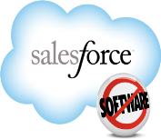



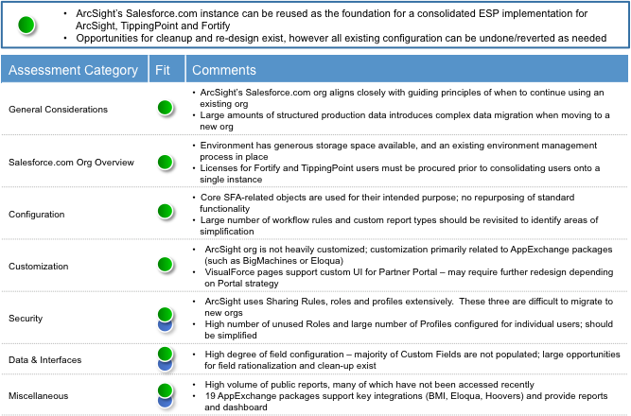
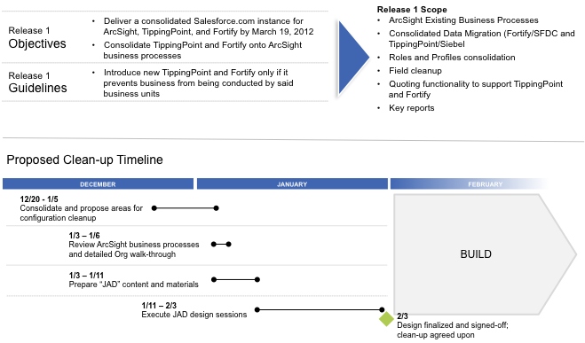
Salesforce.com Environment Evaluation
Different Salesforce.com Environments
Functionality and Configuration Assessment
General
Considerations
Salesforce.com Org Overview
Data & Interfaces
Customization
Configuration
Security
AppExchange
Products
Apex Triggers & Classes
Visualforce Pages
Evaluation of Existing Salesforce.com Instances
Licensing and User Activity within each environment
Determine Data Usage & File Storage
Evaluate Data Structure within each environment
Historical Data Access & Archiving Strategy
Evaluation of key areas within salesforce.com instances
Leverage past project expertise to identify areas for potential improvements and areas for consolidation
Recommendation & Org Preparation
Recommendation on a detailed assessment and analysis of current salesforce.com instances
Recommendation on iterative approach to consolidation of the environments minimizing risk and maximizing opportunity for success

Slide 8
Detailed activities for an Environment Evaluation
Areas of Interest | Key aspects of the evaluation
Overall | Evaluate if the consolidation initiative aligns closely with guiding principles of when to consolidate different SFDC orgs Environment has limited storage space available, and an existing environment management process through consolidations Licenses consolidation and combining of support resources throughout the consolidation Address Data Storage, File Storage, API Limits, Field Limits, Apex Coding Limits during the evaluation
Configuration | Core standard objects are used for their intended purpose; identify repurposing of standard functionality and identify approach Workflow rules, custom report types, validation rules, assignment rules, queues should be revisited to identify areas of simplification and consolidation
Customization | Identify areas of high customization and identify simplification and consolidation for an optimal approach Evaluate areas of complex functionality and how to implement for the consolidated system Assess purpose of Apex Triggers and Visualforce pages; identifying adjustments or simplifications that can be utilized across multiple businesses
Security | Assess how sharing rules, roles and profiles have been implemented. Identify feasibility of a single role hierarchy across all instances; areas of combining profiles and field level accessibility Identify information that can / cannot be shared across the organization Usage of permission sets, profiles, roles to control data security
Data | Conduct data profiling for data quality, and identify the set of data that need to be migrated Identify volume of records that need to be accessed across the businesses Identify conflicts in field usage, gaps in usage
Integrations | Overall inventory of boundary systems needed to be accessed across all salesforce.com instances; Unneeded integrations should be nixed and additional integrations should be identified based on capabilities Identify the middleware tool established to communicate to boundary systems
3rd Party Applications | Inventory and Analysis of AppExchange packages and usage

Slide 9
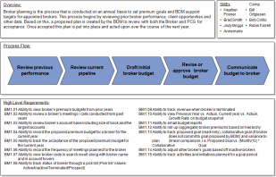
Approach – Solutions Architecture
The emerging operating model created is used to drive the design of the solutions architecture
Key Inputs
Draft process profiles
Insight into regional / business model variations
Current application and integration landscape and salesforce.com designs
Accelerators Used
Enterprise Value Map
IndustryPrint™
Application & Integration Architecture Leading Practices
Key Activities
Key Outputs
Understand current systems & integration landscape
Understand current data architecture and issues
Review consolidated SFDC solutions against emerging process profiles and critical requirements
Develop batch & real time integration architecture strategy
Develop preliminary data and application integration approach
Target Solutions Architecture
Application
Integration Strategy
Data Migration Approach
Solutions Architecture Governance Process
Notes:
Need to note this is Release 0

Slide 10
Approach – Roadmap Development
The following principles will serve as a guide through development of the roadmap
Org Consolidation Guiding Principles
Ensure Leadership involvement throughout the process
Build tangible, actionable projects to help move the organization forward
Build the foundation off of the Baseline recommendations
Align with other Firm initiatives and their dependencies
Mitigate disruption to business operations
Deliver highest priority capabilities as soon as possible to build momentum
Balance overall cost, availability of resources, and risk with delivery of key functionality
The roadmap serves as a guide on how to plan and successfully approach org consolidation into a single Salesforce.com instance to fully realize the benefits and synergies across the company

Slide 11
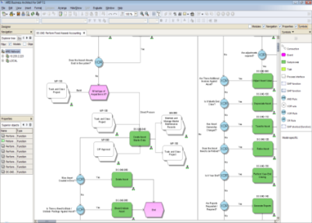
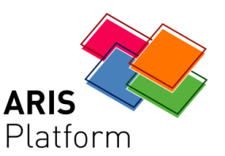

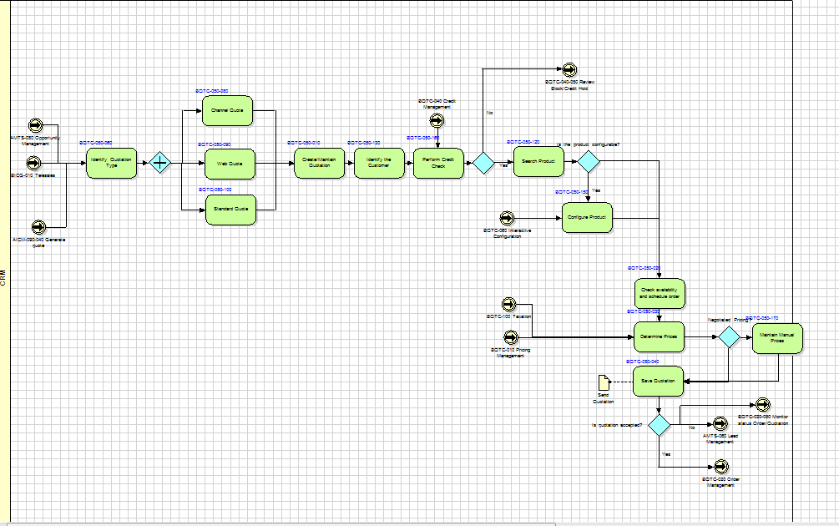
Accelerator: IndustryPrint™
IndustryPrint™ combines Deloitte’s time-tested approach and experience in business process modeling with ARIS, the market-leading modeling platform. Deloitte simplified the use of ARIS on projects by providing our own preconfigured solution for business process modeling. We did the heavy lifting to provide valuable benefits to your business and projects
Process modeling content – IndustryPrints
Why use IndustryPrint™?
Reflects best practices for key processes in 30+ industry segments
Represents a modeling approach used on thousands of Deloitte projects since 1996
Reuse leading practices for business processes
Initiate the illustration and documentation of improved business processes
Define and depict process scope
Kick-start high-level design sessions
Provide hierarchy and common structure to relate deliverables, including requirements for roles and responsibilities, change, risk, control, training, and testing
Facilitate the analysis of performance and improvements (“what-if” questions)
Help design to-be processes for achieving greater organizational efficiency
IndustryPrints
Process modeling platform – ARIS
Software IndustryPrint™
Manages the graphical representation of process modeling content
Captures the level of detail necessary for process modeling design, including requirements, fit/gap, business roles, custom development objects, and screens
Incorporates Deloitte’s project method

Slide 12
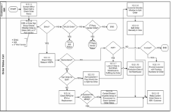
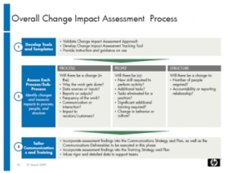
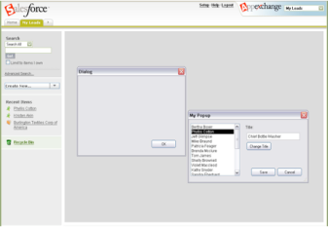
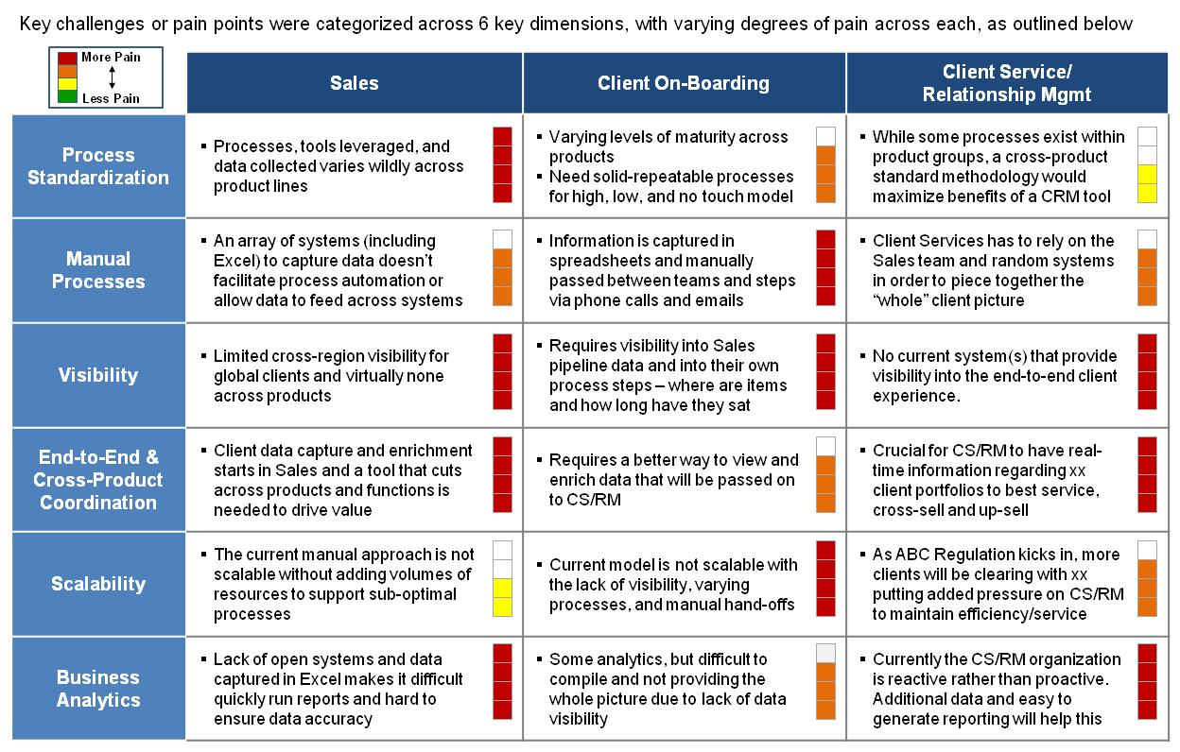
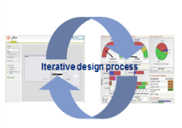
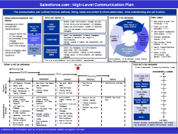
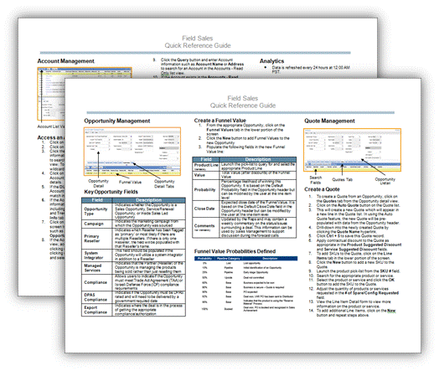
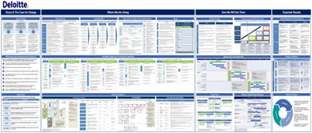
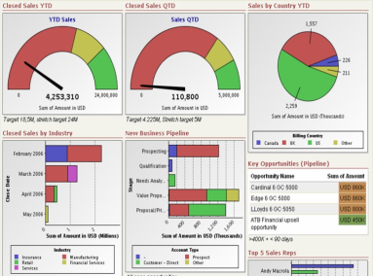
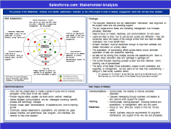
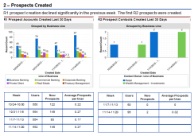
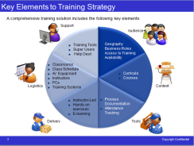
Org consolidation Tools and Accelerators
Deloitte has developed a robust and broad range of tools and accelerators that are integrated with our methodology and tailored for Salesforce.com
JAD Process
Schema Extractor
Data Management Framework
Organizational Impact Assessment
Using Deloitte’s readiness assessment recognize gaps in willingness and capability for a Salesforce.com implementation
Allows to extract configurations, and compares across different SFDC organization to accelerate configuration related activities
Provides the framework for data management and drive decision making for org consolidation
Identify how individuals and teams are impacted as a result of the changes in roles, processes, and technology
Training Strategy Tool
Org Evaluation Toolkit
Rollout Plan
User Adoption Report
Define a Training strategy to outline our approach, timeline, development and review process, roles and responsibilities, and enrollment and tracking
Toolkit to support a comprehensive org evaluation across multiple SFDC instances, and assist in presenting findings to the stakeholders
Build Salesforce.com communities and capabilities by outlining and preparing the organization, following a detailed plan and approach
Provide and communicate a comprehensive view of the adoption of Salesforce.com by users that have completed training and been migrated into the tool

